Slide 1
Apollo Sugar Clinic: Complications Micro vascular complications: Diabetes Retinopathy
8_84
Healthcare outcomes delivery is what we assure
Notes:
Apollo Sugar holds the Proprietary right for the content presented. Data or Insights can neither be published nor reproduced without permission from Apollo Sugar

Slide 2
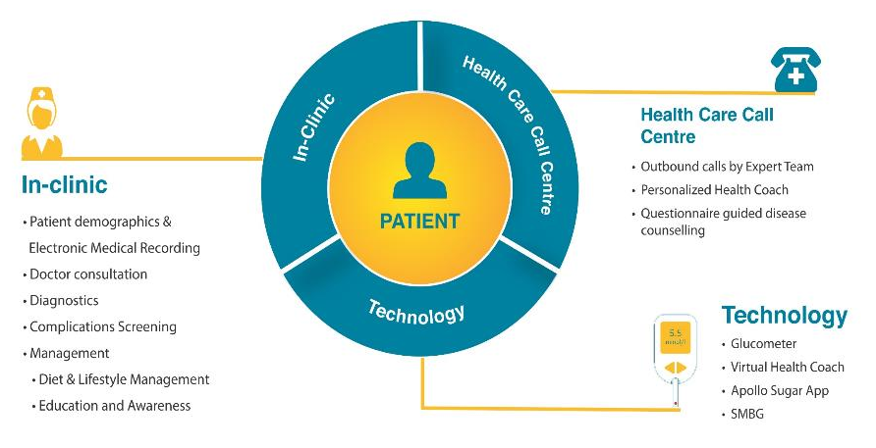
What is our integrated care model?
A patient centric model to deliver condition management – brick and mortar and remote
Self- discipline achieved by Sugar education and Awareness
S
M
A
R
T
Monitoring and Medication : SMBG, Acceptance and Compliance
Adherence: Diet, exercise and life style modification
Rx compliance and regular BS monitoring
Technology & Training: Constant connect, 2-way engagement, and training
We are empowering patients with VIDEOCONSULTATION FACILITY to have easy access and reach-out to Doctors and care team at their convenient time through Apollo Sugar App
Apollo Sugar holds the Proprietary right for the content presented. Data or Insights can neither be published nor reproduced without permission from Apollo Sugar

Slide 3
Our Typical Patient Pathway
Pre-Doc
Vitals
EMR Recording
Completion of Investigations
Reception
Meet and greet
Registration (UHID issued)
Doctor Consultation
All patient data and interactions on EMR throughout pathway
Contact Centre / Online
Expert Diabetes Management Call Centre – for both patient appointment booking and post sales patient engagement
Online and Offline support through Health coach Video-consultations through Sugar App
Patient Journey @ Apollo Sugar
Diabetes Educator
Insulin Training
Exercise
Stress
Lifestyle
Dietician
Nutritional Assessment
Counselling
Patient Take-aways
Fully synched Mobile App
Diet Prescription
Contact Centre/Health Coach
UHID, Patient file with all test results, Rx, holistic treatment plan
Apollo Sugar holds the Proprietary right for the content presented. Data or Insights can neither be published nor reproduced without permission from Apollo Sugar

Slide 4
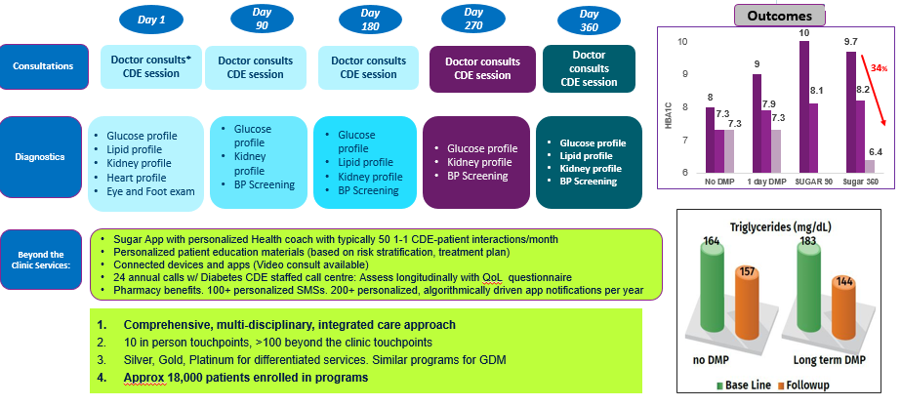
Sugar 360: A Full Scale Annual Program
Apollo Sugar holds the Proprietary right for the content presented. Data or Insights can neither be published nor reproduced without permission from Apollo Sugar

Slide 5
Our Population Health Outcomes
87% patients have been well managed by Sugar care teams to achieve better health outcomes and quality of life
41% are at targets of HbA1c and 36% achieved/improved as per physician set targets
15% who are deranged(>9%) initially, around 13% were improved or reached targets
To From | Deranged | Improved | At targets
Deranged (>9%) | 15% | 9% | 4%
Improved (as per physician definition) | 7% | 21% | 13%
At targets (<7%) | 1% | 6% | 24%
HbA1c deranged
(~23%)
Patients enrolled in Sugar Diabetes Management Program achieved:
Superior outcomes in terms of HbA1c reduction
All the patients enrolled in DMPs were under control and at targets for total Cholesterol per ADA guidelines
All the female patients enrolled in DMP were at control for Triglycerides and there is a meaningful reduction in triglycerides level in Male patients
Showcases the 360 degree approach provided by Sugar which is not only limited to HbA1C management
HbA1c control
Improved and at targets
(~77%)
Note: At targets: <7%; Improved: >7-<9%; Deranged: >9%
Apollo Sugar holds the Proprietary right for the content presented. Data or Insights can neither be published nor reproduced without permission from Apollo Sugar

Slide 6
Diabetic Retinopathy
Diabetic retinopathy (DR) is the most common cause of blindness in patients with Diabetes mellitus
Retinopathy is of two types Non-proliferative diabetic retinopathy (NPDR) and proliferative diabetic retinopathy (PDR)
Microscopic changes occur in the blood vessels of the eye in non-proliferative disease, however do not produce symptoms and are not visible to the naked eye.
Non-proliferative disease progresses from
Mild NPDR
Moderate NPDR
Severe NPDR
Apollo Sugar holds the Proprietary right for the content presented. Data or Insights can neither be published nor reproduced without permission from Apollo Sugar

Slide 7
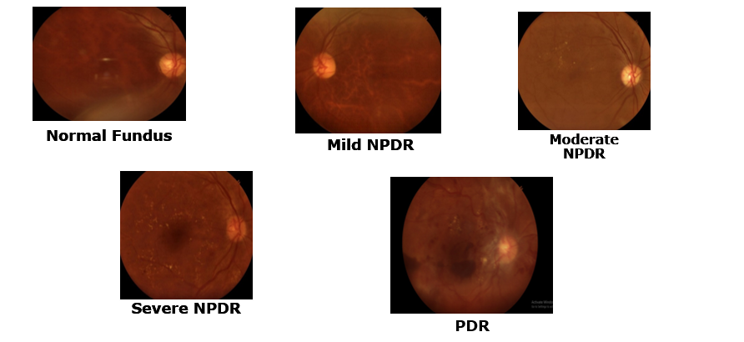
Fundus reports
Apollo Sugar holds the Proprietary right for the content presented. Data or Insights can neither be published nor reproduced without permission from Apollo Sugar

Slide 8
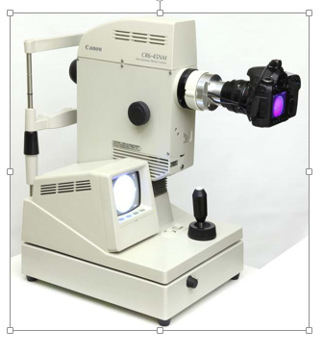
Initiatives at Apollo Sugar Clinic
A comprehensive eye examination to high risk individuals is done at Apollo Sugar Clinic using Nondialated Fundoscopy to detect retinopathy and macular edema
Individuals with diabetic retinopathy are advised to be a part of Apollo Sugar diabetes care program, through patient’s SMBG, diet, medication are closely monitored to ensure Diabetes is under control.
Apollo Sugar holds the Proprietary right for the content presented. Data or Insights can neither be published nor reproduced without permission from Apollo Sugar

Slide 9
Clinical data on Diabetic retinopathy screening at Apollo Sugar Clinic
Apollo Sugar holds the Proprietary right for the content presented. Data or Insights can neither be published nor reproduced without permission from Apollo Sugar

Slide 10
Pan India: Prevalence of Diabetic Retinopathy
Of the total 14998 screened diabetes patients 92% of the patients had normal fundus and in 8% retinopathy was observed

Slide 11
Data on Fundus examination done across Apollo Sugar clinics from 2016-2018
Eye Reports | No. of patients screened | Percentage
Normal | 13793 | 91.97%
Mild NPDR | 791 | 5.27%
Moderate NPDR | 297 | 1.98%
Severe NPDR | 69 | 0.46%
PDR | 20 | 0.13%
Cataract | 22 | 0.15%
Total reports | 14998
Apollo Sugar holds the Proprietary right for the content presented. Data or Insights can neither be published nor reproduced without permission from Apollo Sugar

Slide 12
Data on Fundus examination done across Apollo Sugar clinics from 2016-2018- Gender distribution
Of 14998 patients who underwent eye examination, 37% were females and 63% were males
Retinopathy changes noticed:
Males: 5%
Females: 3%
Apollo Sugar holds the Proprietary right for the content presented. Data or Insights can neither be published nor reproduced without permission from Apollo Sugar

Slide 13
Data on Fundus examination done across Apollo Sugar clinics from 2016-2018- Age distribution
Of 14998 patients who underwent eye examination, 20% were ≤40 years and 80% were >40 years of age.
Retinopathy changes noticed:
≤40 years: 3%
>40 years: 9%
Apollo Sugar holds the Proprietary right for the content presented. Data or Insights can neither be published nor reproduced without permission from Apollo Sugar

Slide 14
Our Research publications on Diabetic retinopathy
Apollo Sugar holds the Proprietary right for the content presented. Data or Insights can neither be published nor reproduced without permission from Apollo Sugar

Slide 15
Prevalence of Diabetes Eye Disease and its Correlation with Renal Function in a Chain of Community Clinics in India
Kalpana Dash, Krishna G Seshadri, Apollo Sugar Research Group
Objective: To determine the prevalence of DED and its association with glomerular filtration rate (GFR) in a community clinic population across sugar clinics in India
Results:
A total of 1547 T2D patients were analysed, among these patients diabetes associated eye diseases were observed in 204 (13.1%) patients, their mean (SD) age was 56.7 (10.0) years.
Though not significant DED prevalence was higher among male (122 [59.8%]) patients compared to females (82 [40.2%]) patients.
Further, out of total 1547 T2D patients, GFR was calculated for 443 patients with mean GFR value of 91.2 (30.2) mg/ml/1.73 m2. Of these patients 388 (87.5%) had GFR ≥60 and 55 (12.5%) patients had GFR ≤60
Among 443 patients with GFR calculated, DED was observed in 79 (17.8%) patients, mean (SD) age 55.5 (13.8) years; among them 49 (62%) males and 30 (38%) females.
GFR was significantly lower in patients with DED compared to patients without DED (79.4 vs. 93.8 mg/ml/1.73m2; p=0.000).
Prevalence of DED in patients with GFR ≤60 was higher compared to patients with GFR ≥60 (38% vs. 15%; p=0.000).
Although there was high preponderance of male diabetes patients, there was no specific gender variation with DED prevalence in both GFR ≥60 and ≤60 group patients.
Prevalence of DED in low GFR T2D patients
Conclusion:
The current study is one among the few studies that reported the association of eye disease with low GFR may suggest the presence of DKD in a community, thus, reiterating the significance of early screening for eye complications in community based diabetes practices.
Therefore, implementing these real time clinical observations into clinical decision pathways may improve the quality of health care delivery.
Apollo Sugar holds the Proprietary right for the content presented. Data or Insights can neither be published nor reproduced without permission from Apollo Sugar

Slide 16
Thank you. Reach us on 18001031010
For Queries/ Concerns/Research initiatives, contact: Dr. Vamsi Krishna Kolukula Head- Clinical Excellence, Apollo Sugar Clinics Mail: drvamsi.kolukula@apollosugar.com Contact no: 9515132411
Apollo Sugar holds the Proprietary right for the content presented. Data or Insights can neither be published nor reproduced without permission from Apollo Sugar
Notes:
Apollo Sugar holds the Proprietary right for the content presented. Data or Insights can neither be published nor reproduced without permission from Apollo Sugar

